Slide 1

A Low Latency Digital Filter using Recurrent Neural Network Dissertation I (MCS-392) Jan 6, 2024 Teerthanker Mahaveer University, College of Computing Sciences & Information Technology, Moradabad-244001(India) Session: 2023-24
Guided By:
Presented By: Mohit Singh
(M.Tech-CSE)
Ms. Sukrati Jain
(Supervisor)
&
Mr. Vikas Deswal
(Co-Supervisor)

Slide 2
Contents
Introduction
Problem Statement
Literature Review
Hypothesis
Research Gap
Objective
Research Methodology
References

Slide 3
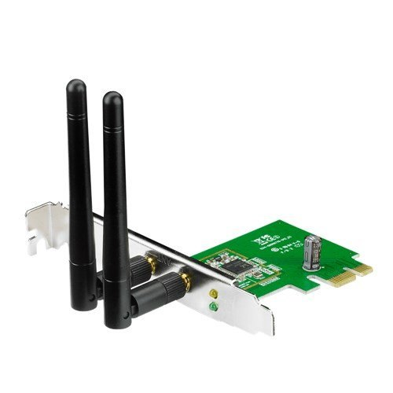
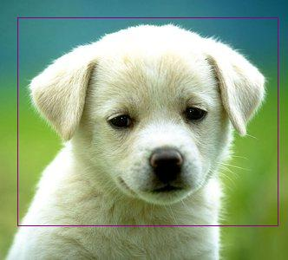
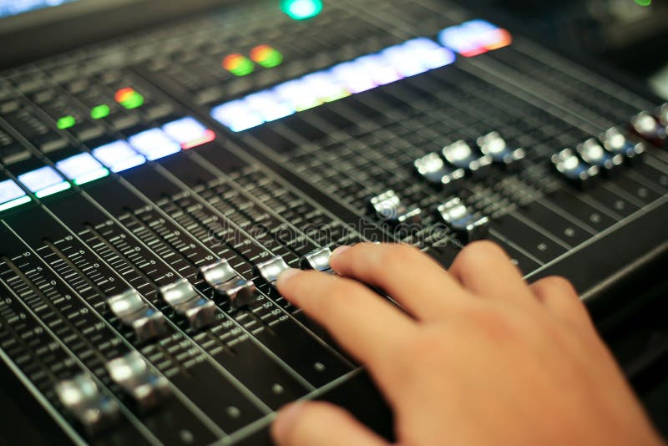
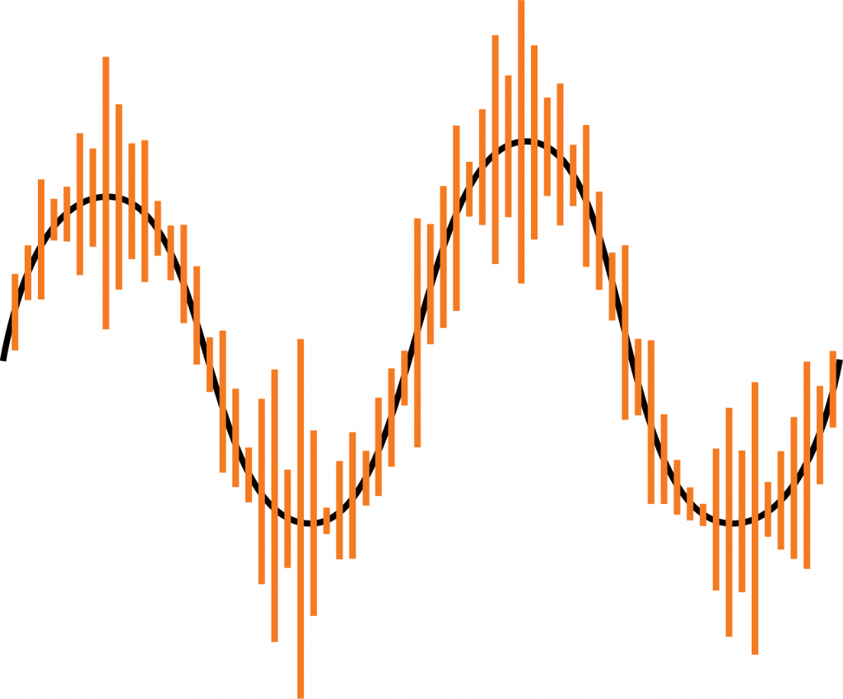
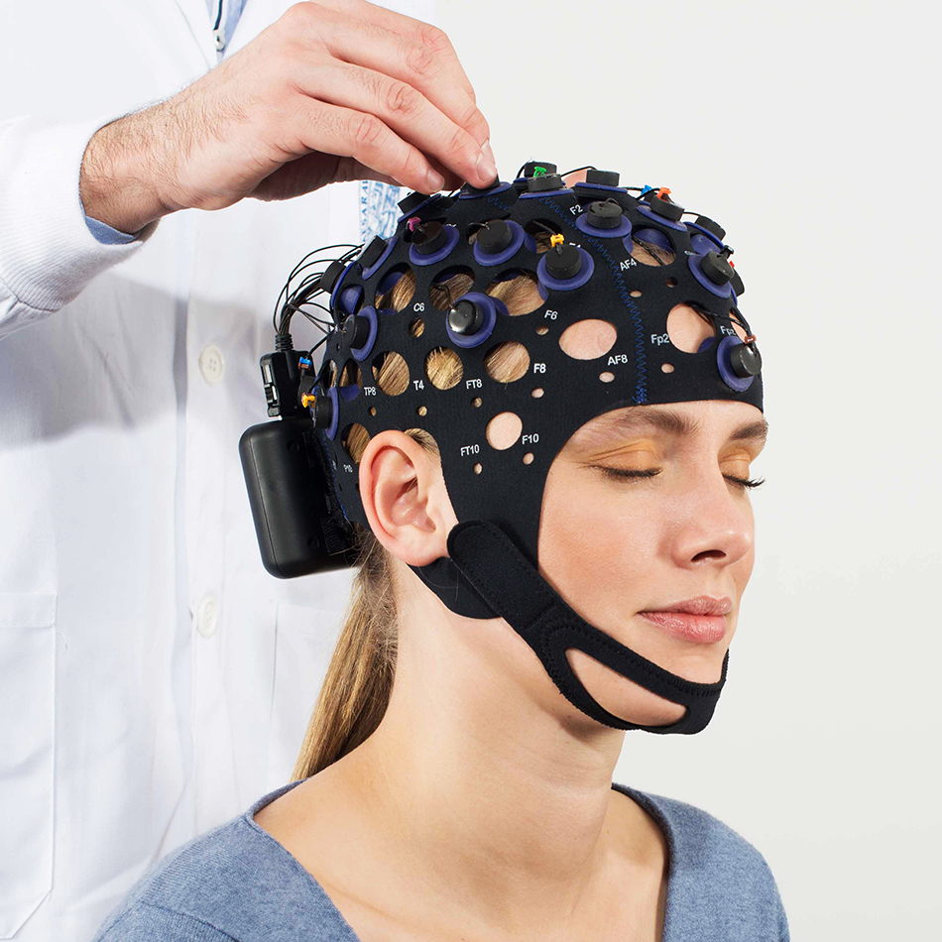
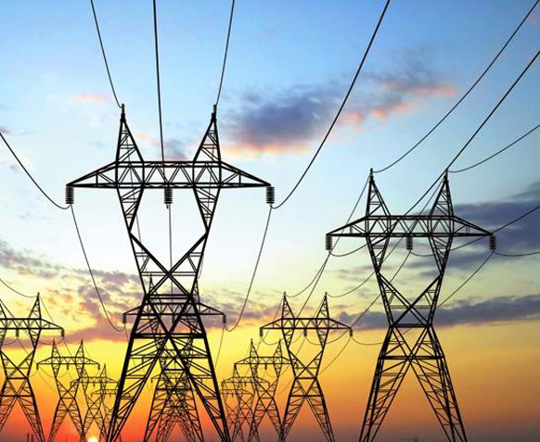
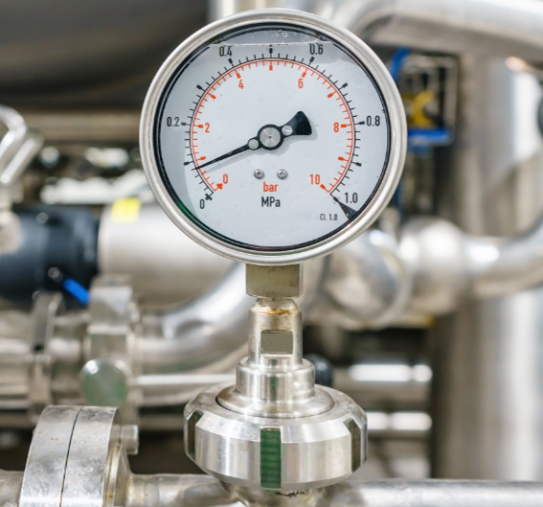
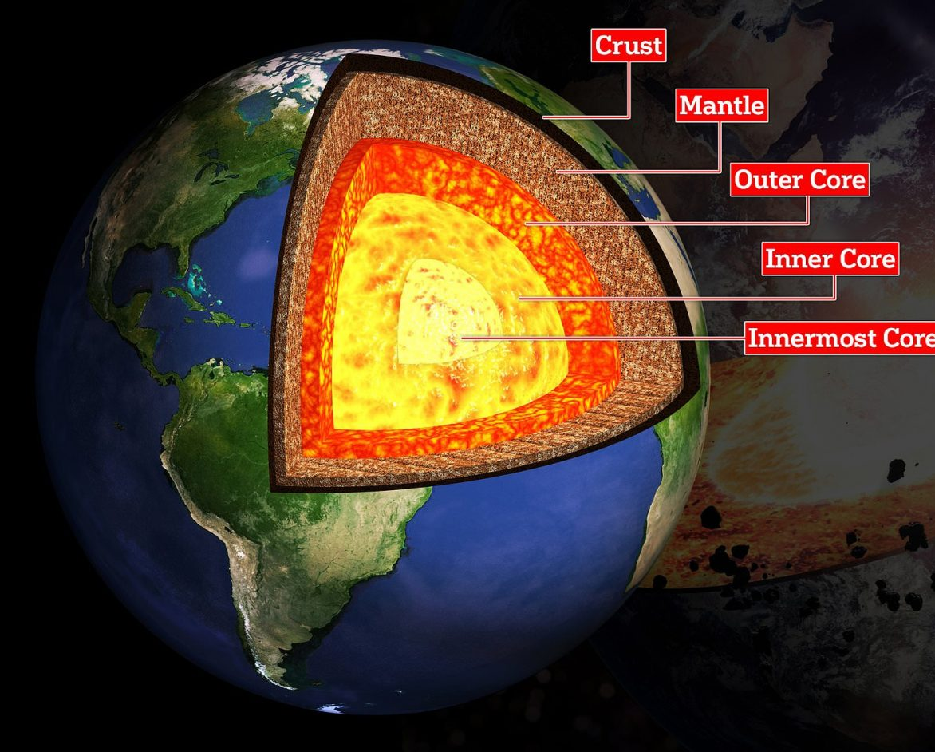
Introduction
Some Important Applications of Digital Filters

Slide 4
Problem Statement
Digital Filters are widely used in DSP for processing of Digital Signals but they still have some problems such as Latency, Non-Causality, Filter Complexity and Difficulty in Real-Time Implementation.

Slide 5
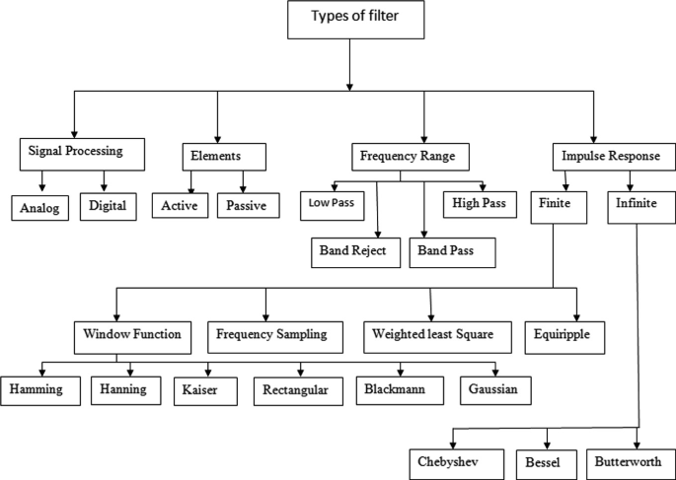
Literature Review
Classification of Filters

Slide 6
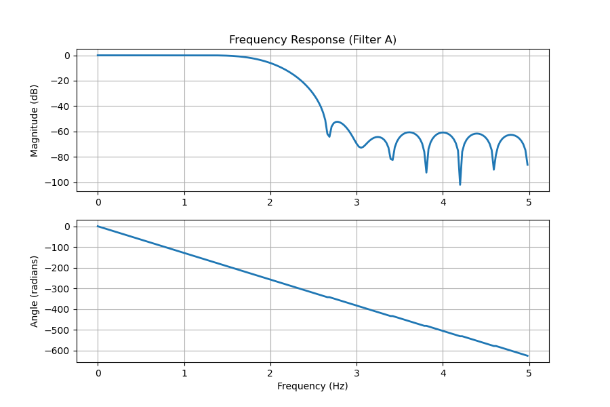
Literature Review
Frequency Response of a Linear Phase Digital Filter

Slide 7
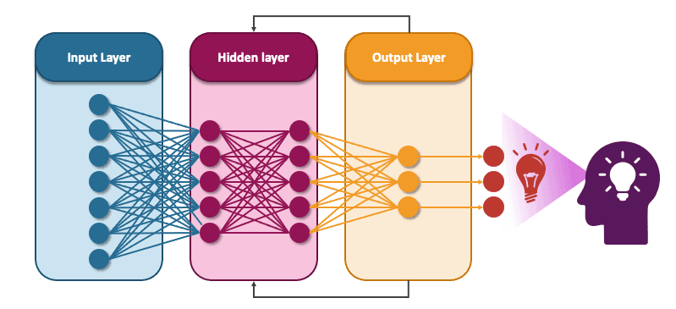
Literature Review
Recurrent Neural Network(RNN)

Slide 8
Hypothesis
Better performance of a digital filter can be achived by designing a constant phase response digital filter using RNN with filter coefficients.

Slide 9
Research Methodology
Calculating Filter Coefficients
Modelling RNN Digital Filter
Programming (Python, Java, C++)
Testing

Slide 10
References
K. Hossain, R. Ahmed, A. Haque, and M. Rahman, “A Review of Digital FIR Filter Design in Communication Systems,” International Journal of Science and Research (IJSR), vol. 10, p. 09, 03 2021.
R. Hinojosa-Meza, M. M. Rivera, P. Vacas-Jacques, N. Escalante-Garcia, J. A. Dena-Aguilar, A. B. Sanchez, and E. Olvera-Gonzalez, “Comparative Analysis of RNN Versus IIR Digital Filtering to Optimize Resilience to Dynamic Perturbations in pH Sensing for Vertical Farming,” Preprints, May 2023.
D. Kumar, “Comparison of Different Types of IIR Filters,” 04 2016.
R. Pal, “Comparison of the design of FIR and IIR filters for a given specification and removal of phase distortion from IIR filters,” 12 2017.

Slide 11
References
S. Zargar, “Introduction to Sequence Learning Models: RNN, LSTM, GRU,” 04 2021.
A. Antoniou, Digital Signal Processing, vol. 1. McGraw-Hill Publications, 2006.
S. Winder, Analog & Digital Filter Design, vol. 2. Elsevier Science (USA), 2002.
I. Goodfellow, Y. Bengio, and A. Courville, Deep Learning. MIT Press, 2016. http://www.deeplearningbook.org.

